Slide 1
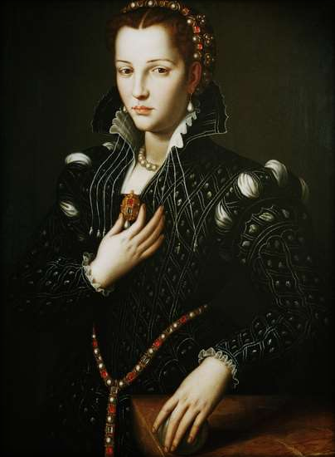
Dr. S.M. Baggio

Slide 2
Starter
 Why might a man keep a picture of his dead wife
behind a curtain?

Slide 3
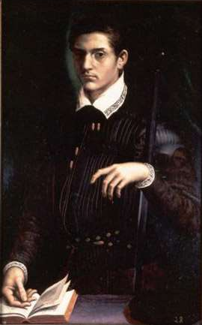
Speaker?

Duke Alfonso II of Ferrara, Italy.
In 1561, the Duke’s first wife Lucrezia died in suspicious circumstances.
There were rumours she was poisoned.
Hearing about this event inspired Robert Browning to write the poem in 1842.

Slide 4
Looking as if she were alive.
That's my last duchess painted on the wall,

 Dramatic monologue
 The Duke speaks about a dramatic moment in his life.
 He speaks to someone (an auditor) but we don’t hear them talk back.
 We get insight into the Duke’s personality from what he says to the listener.
At this point in the poem, we don’t know who the Duke is speaking to about his “Last Duchess”.
Ekphrasis: a work of art (poem) about a work of art (painting).
Poem begins and ends discussing art.

Slide 5
I call
That piece a wonder, now: Frà Pandolf's hands Worked busily a day, and there she stands.

“that piece”-the painting.
“Fra Pandolf”-an imaginary artist invented by the writer.
“Fra” is short for “Friar”-which means brother. The artist is a monk.
He asks the listener to sit down and look at the picture.
Will't please you sit and look at her?

Slide 6
Deliberately
Metaphor: reading a face like a book
Countenance:
face

I said
by design,
"Frà Pandolf" for never read
Strangers like you that pictured countenance,
The depth and passion of its earnest glance,
Three adjectives: used to describe
the unusual expression/look on
her face. What do they each mean?

Slide 7
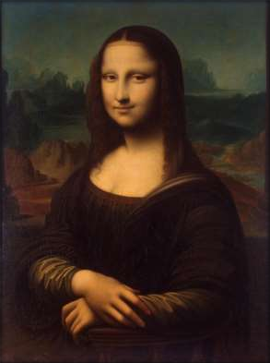
Question

What is this picture called?
Why is it so famous?
Enigmatic smile.

Slide 8

Nobody looks at that face without turning to me…
Brackets/parenthesis/aside:
the Duke tells the listener the painting is behind a curtain. Why?
But to myself they turned
(since none puts by
The curtain I have drawn for you, but I)
dared
And seemed as {IF} they would ask me, if they durst,
How such a glance came there; so, not the first
Are you to turn and ask thus.
How such a strange
expression/look got there.
The listener must have asked the question.

Slide 9
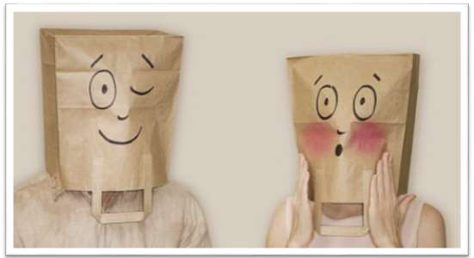
Sir: addresses listener formally. “’Twas” short for “it was”.
Blush

Sir, 'twas not
Her husband's presence only, called that spot Of joy into the Duchess' cheek:
What is the Duke suggesting here?

Slide 10
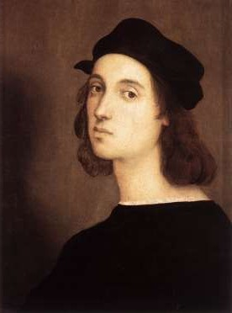
perhaps
Mantle: edge of cloak. i.e. show me more arm
Frà Pandolf chanced to say

"Her mantle
laps/Over my lady's
wrist too much,”
or
"Paint
Must never hope to reproduce the faint Half-flush that dies along her throat"
Paid her a flattering compliment.
“My paint can never reproduce your beauty.”

Slide 11

Courtesy: good manners
such stuff
Was courtesy, she thought, and cause enough
For calling up that spot of joy.
What do we think the Duke thought?

Slide 12
What is the Duke suggesting here?
Note the repetition in this section

She had
A heart how shall I say? too soon made glad, Too easily impressed; she liked whate'er
She looked on, and her looks went everywhere.
Anaphoric repetition-
repeating words at the beginning of clauses
Polyptotonic repetition-repeating words from
the same root with slight variations

Slide 13
All the same
A gift, sometimes flowers. Suggests
he “favours” her above others. She is lucky to have him
Sir, 'twas all one!

The sunset
My favour at her breast,
The dropping of the daylight in the West,
The branch
The bough of cherries some officious fool
Broke in the for her,
orchard
Interfering
Place where fruit trees grow
the white mule/ She rode with round the terrace
all and each Would draw from her alike the approving
speech,/Or blush, at least.
Why do you think he keeps coming back to the blush?

Slide 14
Structure: mark on the syllable beats in the lines (over every vowel sound)
 |  | Simile-as if anything was as good as his ancient family name.
Suggests she thanks them in other ways?

x / x / x / x / x /
Or blush, at least. She thanked men good! but thanked
Somehow I know not how as if she ranked My gift of a nine-hundred-years-old name
x / x / x / x / x /
x / x / x / x / x /
x / x / x /
The poem is in iambic (x/)
With anybody's gift.
pentameter-5 heavy beats per line

Slide 15
Stoop: bow low.
Blame: criticise
Trifling: small, silly behaviour

Fake modesty? He
can speak well really.
Who'd stoop to blame
This sort of trifling? Even had you skill
In speech which I have not to make your will Quite clear to such an one, and say, "Just this "Or that in you disgusts me; here you miss,
"Or there exceed the mark" and if she let
Forsooth=in truth.
Herself be lessoned so, nor plainly set
Her wits to yours, forsooth, and make excuse, E'en then would be some stooping; and I choose
Never to stoop.
Even if you wanted to correct her
Probably the most revealing errors, and she listened and didn’t
bit about the Duke. What
argue back or make excuses, that would mean “stooping”.
does it tell us about him?

Slide 16
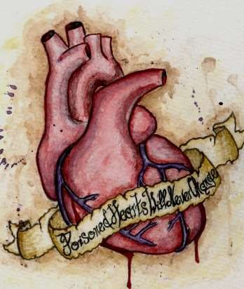
What grew? Her “blushing” or his jealousy?
Rhetorical question.
Oh sir, she smiled, no doubt,
Whene'er I passed her; but who passed without Much the same smile? This grew; I gave commands; Then all smiles stopped together.
Euphemism: nicer way of saying “dead”
Gave orders, and had her
assassinated. Powerful.

Slide 17

The Duke’s thoughts return to the painting.
There she stands
As if alive. Will't please you rise? We'll meet The company below, then.
He turns back to the listener and asks, “Would you like to get up?”

Slide 18
Gets down to business
The listener is an envoy or messenger sent by a Count to arrange the Duke’s next marriage (to the Count’s daughter).
I repeat,

The Count your master's known munificence
Is ample warrant that no just pretence
Generosity
Of mine for dowry will be disallowed;
Though his fair daughter's self, as I avowed
At starting, is my object.
Enough of a guarantee
“Although, I only want her for her beauty really”-Do we believe him?
That no request from me
for a dowry (money paid to a husband by the bride’s family) will be refused.

Slide 19
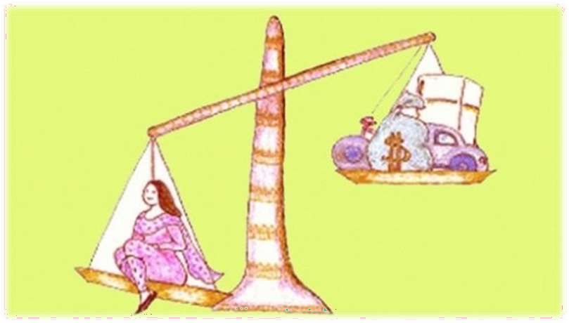
What does this picture have to do with the end of the poem?


Slide 20
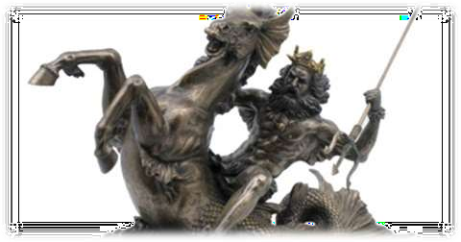
Another fictional artist made up by Browning.
Roman god of the sea.

Nay we'll go
Together down, sir. Notice Neptune, though, Taming a sea-horse, thought a rarity,
Which Claus of Innsbruck cast in bronze for me.
He returns to the subject of his art collection, which emphasises his power and wealth. The story of his last duchess is a subtle warning to his visitor about how he expects his next wife to behave.

Slide 21
Group 1: The Duchess

What do we learn about the last Duchess from the Duke’s monologue?
Where is your evidence?
Can we trust what he is telling us?

Slide 22
Group 2: The Duke

Some people say that this poem is more a portrait of the Duke than the Duchess.
What do we learn about the Duke’s personality from what he tells the envoy in the poem?
Where is your evidence?

Slide 23
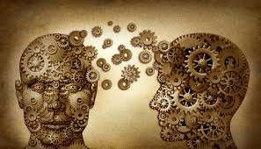
Feedback


Slide 24
Questions

Do you think the Duke ever had any affection for the Duchess? Why/Why not?
How is the Duke’s view of himself different from the way the reader sees him?
Is the title of the poem effective? Why/Why not?
Why does the Duke show the envoy the artwork?
Why does he tell him about the Duchess?
Why do you think we only find out who the listener is at the end?

Slide 25
Feelings and attitudes

 Pride: the Duke is very proud of his possessions (including his wife!) and his nine hundred year old name.
 Jealousy: he couldn’t stand the way the Duchess treated him the same as everyone else. Doesn’t she know who he is?
 Power: the Duke enjoys the control he has over the painting-he couldn’t control his wife in life-he can now she is dead.

Slide 26
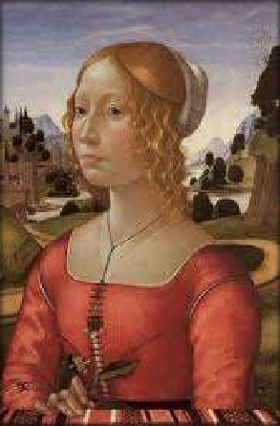
Themes and comparisons
 Power (humans)-Ozymandias, London, Storm on the Island, Tissue, Checking out Me History.
 Memory- The Prelude, Remains, Poppies, War Photographer, Checking out Me History.
 Negative emotions (pride)- Ozymandias.
 Identity-Poppies, Tissue, The Emigree, Kamikaze, Checking out Me History.

